Slide 1
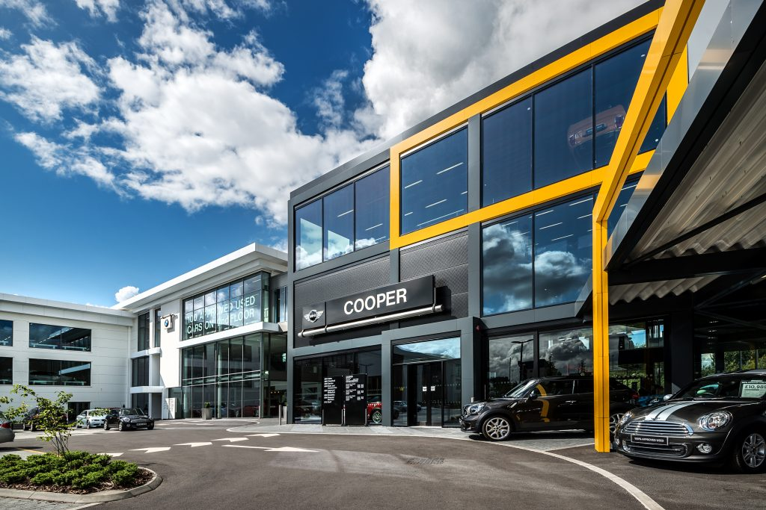

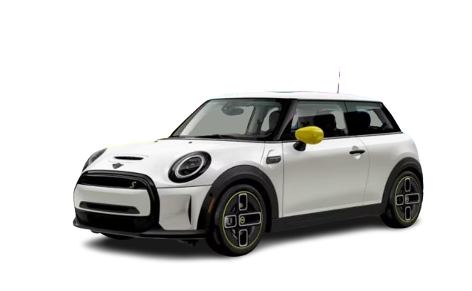
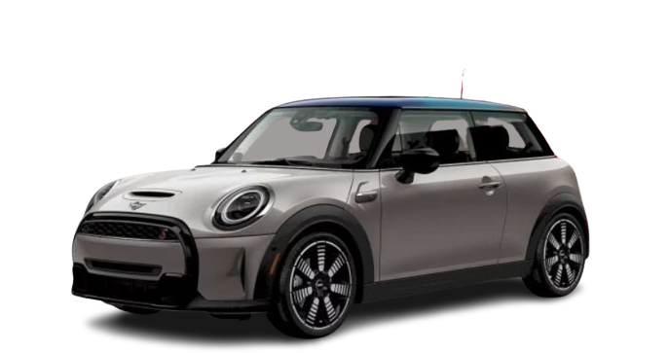
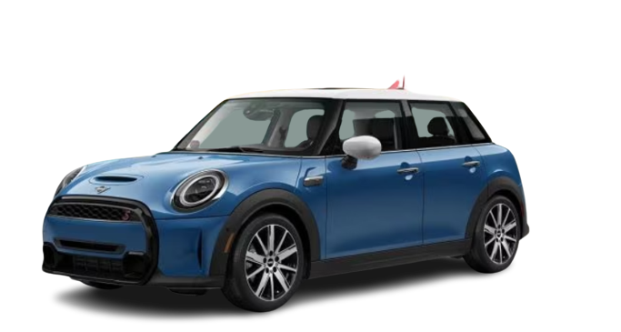
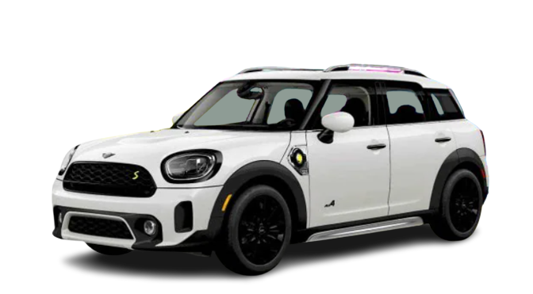
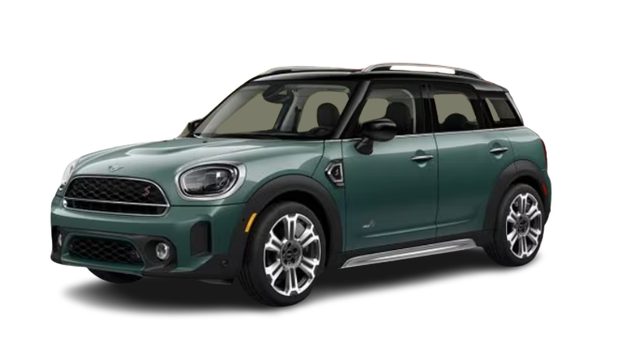
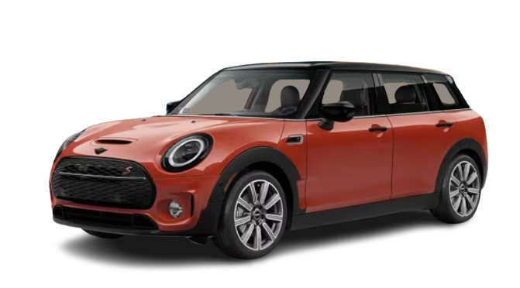
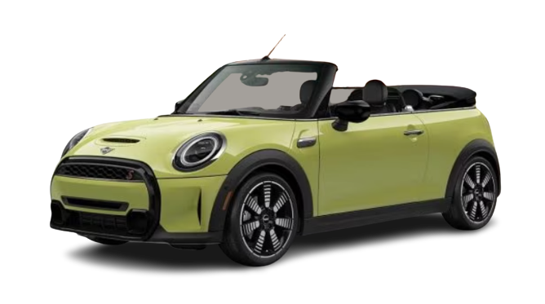

Slide 2
ELECTRIC HARDTOP
Legendary design meets all-electric power, this electric hatchback is loaded with more standard
premium features and a reinvigorated dashboard.
Includes a High-Voltage Lithium-Ion Battery Limited Warranty.
$36,700

Slide 3
HARDTOP DOOR
The MINI that started it all. This subcompact hatchback and cultural icon has a few new tricks up its sleeve like a Twin Power Turbo engine and 3 adjustable driving modes.
$28,600

Slide 4
HARDTOP 4 door
The turbocharged motoring icon—with double the doors. Plus a little more elbow room, a little more legroom and a little more cargo room. This compact hatchback checks all your tech and safety boxes too.
$29,700

Slide 5
Countryman
The biggest, most adventurous MINI yet. Generous cargo
and passenger space, along with a full suite of premium
equipment and dynamic ALL4 all-wheel drive. A fun and
fearless small crossover SUV
$32,650

Slide 6
Countryman phev
Go further more sustainably with our crossover hybrid SUV. Agility for days with ALL4 all-wheel drive and an estimated combined range of 300 miles on a full charge. Hybrid drivetrain neutralizes carbon footprint.
$46,275

Slide 7
Clubman
Ushering in a new era of sophisticated versatility with signature split rear doors and a spacious, refined interior. A small station wagon available with ALL4 all-wheel drive. Six doors with tons of six appeal.
$39,650

Slide 8
Convertible
The biggest, most adventurous MINI yet. Generous cargo
and passenger space, along with a full suite of premium
equipment and dynamic ALL4 all-wheel drive. A fun and
fearless small crossover SUV
$33,800

Slide 9
